Slide 1
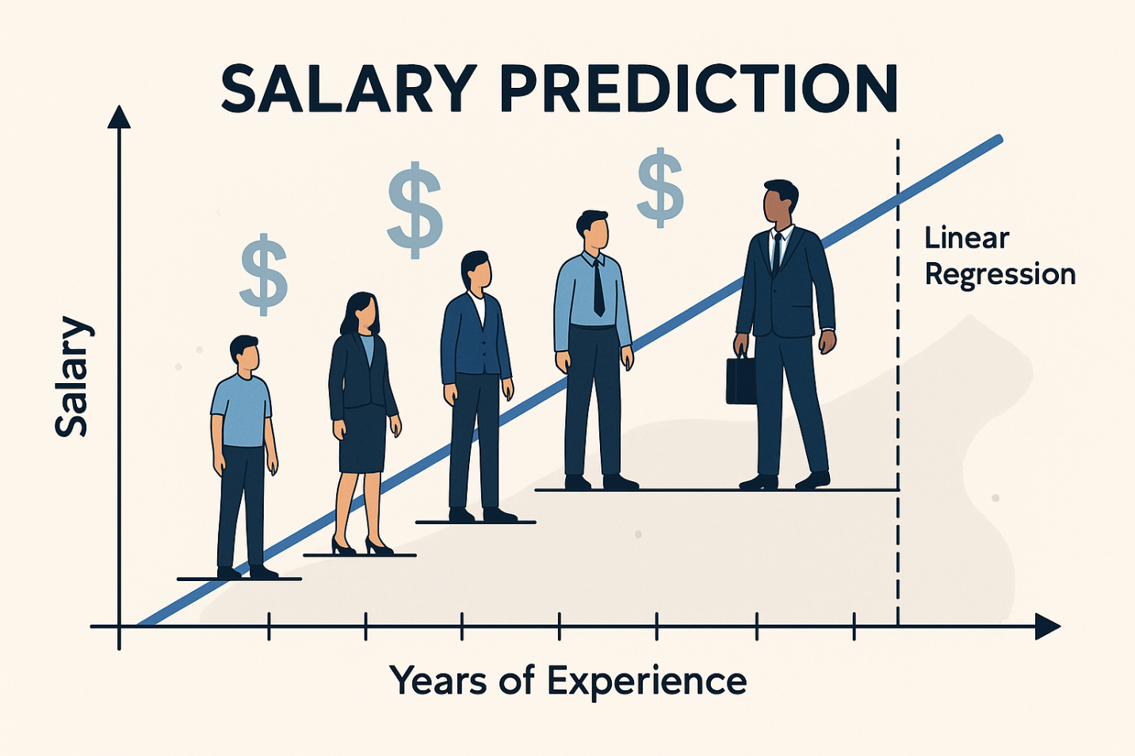
Salary prediction
AutoAI model building in ibm waston studio
Name – Lovely Pandey
CSE/3rd Year
LLOYD INSTITUTE OF ENGINEERING
& TECHNOLOGY

Slide 2

Introduction:
Salary Prediction is a machine learning project where we predict a person's salary based on their years of experience.
In this project, we used AutoAI in IBM Watson Studio to automatically build the best machine learning model.

Slide 3

Objective:
The main objective of this project is:
To predict salary based on experience
To understand how AutoAI automatically builds models
To analyze the relationship between experience and salary

Slide 4

Tools used:
IBM Cloud
IBM Watson Studio
AutoAI
Dataset (Experince vs Salary)

Slide 5

What is AutoAI?
AutoAI is a tool in IBM Watson Studio that:
Automatically selects the best algorithm
Cleans and prepares the data
Trains multiple models
Selects the best performing model
It reduces manual coding and saves time.

Slide 6

Working Process:
Upload dataset (Salary data)
Select target column (Salary)
Run AutoAI experiment
AutoAI builds multiple models
Best model is selected automatically
Model is used to predict salary

Slide 7
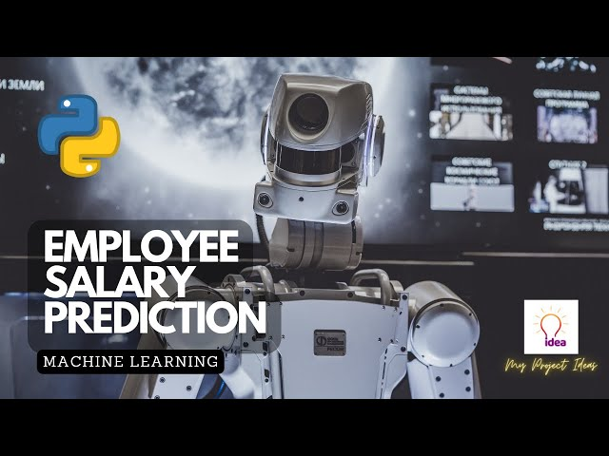
Result:
The model shows a positive relationship between:
Years of Experience ↑ Salary ↑
The graph shows actual salary data and predicted salary line.

Slide 8

Conclusion:
AutoAI makes machine learning easy and fast.
It helps in building accurate models without complex coding.
Salary prediction can help companies in decision making.

